Slide 1
DIGITAL SIGNATURES

Slide 2
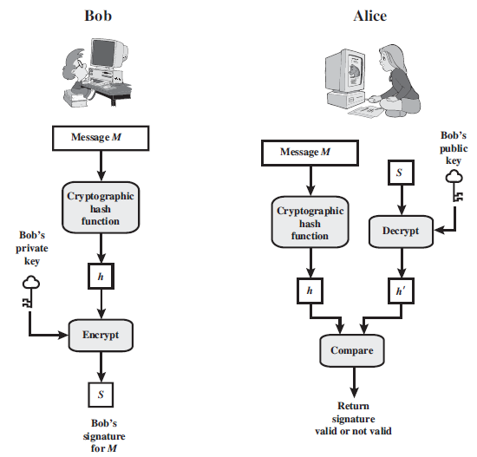

Slide 3
Requirements
The signature must be a bit pattern that depends on the message being signed.
The signature must use some information unique to the sender, to prevent both forgery and denial.
It must be relatively easy to recognize and verify the digital signature.
It must be computationally infeasible to forge a digital signature.
It must be practical to retain a copy of the digital signature in storage.

Slide 4
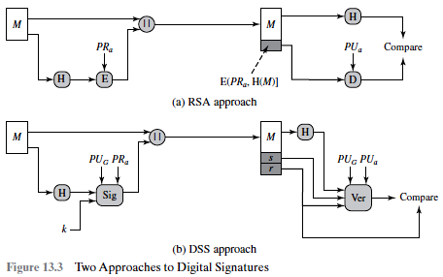
Digital Signature Standard

Slide 5
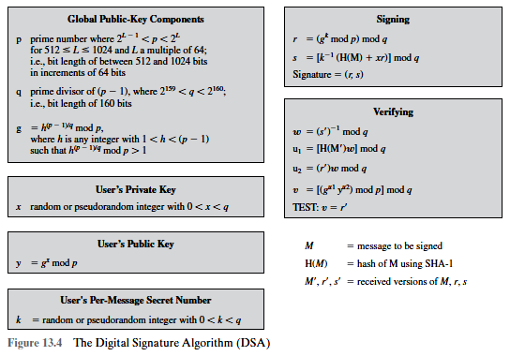

Slide 6
